Slide 1
JAVA PROJECT BATCH
GUI Programming
Lecture 2

Slide 2
Table Of Contents
01.
Introduction To Components.
02.
Creating Button
03.
04.
Adding Button To Frame
Developing AWT Based
Application in Java

Slide 3


Adding Components
• To make our Frame look functional , we must add other GUI elements to it.
But before doing that we must clearly understand 2 terminologies :
Component | Container

Slide 4
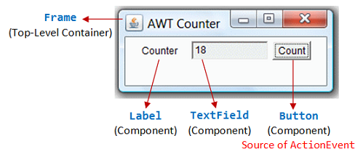
What Are Components ?
• A component is the fundamental UI object in Java.
Everything we see on the display in a Java GUI application is a component.
This includes things like labels ,buttons, checkboxes, scrollbars, lists, menus, and
text fields.

Slide 5
What Are Containers ?
•To be used, a component usually must be placed in a container like Frame .
Container objects group components, arrange them for display on a particular
display device.

Slide 6
The Button Component
• Button is a component that has a text/title and generates an event when pressed.
To create a Button the Java language provides us a class called Button available in the package java.awt

Slide 7
Test Your Understanding
Question: Is every Component a Container ?
Answer: No .
This is because Components cannot hold other Components inside themselves.
However every Container is definitely a Component as it has some functionality of its own also

Slide 8
The Button Component
• Constructors of Button
Constructor | Description
public Button() | Creates a button with no text on it.
public Button(String text) | Creates a button with a text on it.

Slide 9
The Button Component
• Methods of Button
Method Name | Description
public void setLabel(String str) | Sets a String text on button.
public String getLabel() | Gets the String text of this button.
void addActionListener(ActionListener l) | Adds the specified action listener to receive action events from this button.

Slide 10
How To Add A Button On Frame ?
• Following are the steps needed to add a Button on the Frame:
Create a Button object
Set the layout of the Frame to FlowLayout by calling its method setLayout() and passing it the object of the class FlowLayout
Finally add the Button to the Frame by calling the add() method of Frame object and passing it the Button object as argument

Slide 11
What Is Layouting ?
• When we add() buttons (and other components) to a container, a layout manager automatically decides two things :
What size will they be ?
Where on the container will they be added ?

Slide 12
What Is Layouting ?
This is convenient, because we can add components without worrying about the detail.
The layout manager is like a little artist inside the computer.
We say what components we want and the layout manager lays them out in the picture.

Slide 13
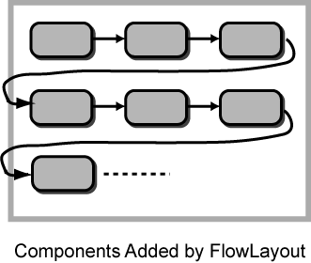
What Is FlowLayout ?
• The FlowLayout is a class available in the package java.awt and it puts the components into the frame row by row in the order they are added.
It picks reasonable sizes for components and decides how many rows to use.

Slide 14
Example
package sca.gui.awt.examples;
import java.awt.Button;
import java.awt.Color;
import java.awt.FlowLayout;
import java.awt.Frame;
class MyButtonFrame extends Frame
{
Button b;
public MyButtonFrame()
{
setTitle("Sachin's Frame");
setSize(400,400);
setLocation(200,200);
setVisible(true);
setBackground(Color.yellow);

Slide 15
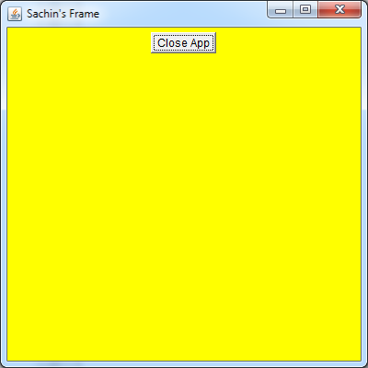
Example
b=new Button("Close App");
FlowLayout fl=new FlowLayout();
setLayout(fl);
add(b);
}
}
public class Example4 {
public static void main(String[] args) {
MyButtonFrame fr=new MyButtonFrame();
}
}

Slide 16


